Slide 1
Slave Narrative Project: Charles Williams
By: Clinton Henderson
Mrs. Martin
African American Literature

Slide 2
Political Purpose of Slavery

Slide 3
Social Purpose of Slavery

Slide 4
Economic Purpose of Slavery

Slide 5
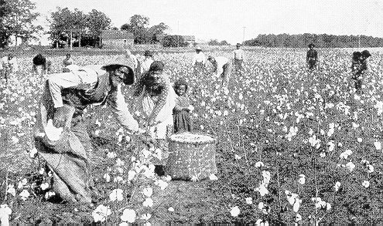
Life in Slavery: Charles Williams
No more than 6 words per bullet
No more than 36 words total
Make sure to understand information
Do NOT read to the class

Slide 6
Excerpt 1: Perspective of Slavery

Slide 7
Explanation of Excerpt 1

Slide 8
Critique of Excerpt 1

Slide 9
Reflection of Excerpt 1

Slide 10
Excerpt 2: Treatment by Slave master

Slide 11
Explanation of Excerpt 2

Slide 12
Critique of Excerpt 2

Slide 13
Reflection of Excerpt 2

Slide 15
Bibliography

